Slide 1
nutrition agent
CAPSTONE PROJECT
Presented By:
1. Meena S-Kingston Engineering College-CSE

Slide 2
OUTLINE
Problem Statement
Proposed System/Solution
System Development Approach
Algorithm & Deployment
Result (Output Image)
Conclusion
Future Scope
References

Slide 3
Problem Statement
In an era where health awareness is growing, individuals increasingly seek personalized nutrition guidance. However, most existing tools provide generic diet plans, lack real-time adaptability, and fail to consider a person's holistic lifestyle, cultural preferences, allergies, and evolving health conditions. Furthermore, dietitians and nutritionists face limitations in scaling personalized consultations due to time and resource constraints.

Slide 4
Proposed Solution
The proposed system aims to address the challenges in personalised nutrition by providing tailored dietary advice. It achieves this by using machine learning and data analytics to analyse individual health data and preferences, as well as natural language processing to understand user queries.
Data Collection:
* Gather user profile data (health goals, allergies, fitness routines).
* Collect real-time multimodal inputs (text, voice, and images of food).
* Maintain a comprehensive nutritional database and medical guidelines via watsonx.data.
Data Preprocessing:
* Clean and process raw user inputs.
* Transcribe voice inputs using IBM Cloud's Speech-to-Text.
* Use an image recognition model to identify food items from photos.
Machine Learning Algorithm:
* Utilize IBM Granity as the core of the LLM-powered reasoning engine.
* Implement Retrieval Augmented Generation (RAG) to ground responses in factual data.
Deployment:
* The solution will be deployed on IBM Cloud Lite services.
* The agent will be accessible via a user-friendly interface (web/mobile app).
Evaluation:
* Assess performance using both quantitative metrics (accuracy of meal plans) and qualitative feedback.
Result:

Slide 5
System Approach
System Requirements
* Cloud Infrastructure: IBM Cloud Environment
* Platform: watsonx.ai and Watson Studio Access
* Cloud Services: Provisioned Lite Plans
* Local Development: Python and IBM Cloud CLI
* Connectivity: High-speed Internet
Required Libraries and Tools
* IBM SDKs: watsonx.ai, IBM Cloud Object Storage
* Connectors: watsonx.data Connectors
* API Client: requests
* Dependency Management: dotenv

Slide 6
Algorithm & Deployment
Model Selection:
* The core of our system is a Retrieval Augmented Generation (RAG) pipeline leveraging the Granite foundation model.
* This approach is chosen because it combines the reasoning power of a large language model with a continuously updated, fact-based knowledge base (watsonx.data), ensuring personalized and scientifically accurate nutritional advice, unlike a static algorithm.
Data Input:
* User Profile Data: Health metrics (age, weight, activity level), dietary preferences, allergies, and specific goals (e.g., weight loss, muscle gain).
* Knowledge Base: The RAG system retrieves data from watsonx.data, including a comprehensive food/recipe database, nutritional composition data, and scientific literature.
* External Data: Processed textual descriptions from the image recognition model of food photos or grocery labels.
Training & Fine-tuning Process:
* Instead of traditional training, we use Prompt Engineering to design effective instructions for the Granite model.
* We can also employ fine-tuning or parameter-efficient fine-tuning (PEFT) techniques within Watson Studio to adapt the Granite model to specific nutritional language and recommendation formats.
* The RAG pipeline itself is trained by indexing the data in watsonx.data to ensure efficient and accurate retrieval of relevant information for each user query.
Deployment Process:
* The model and its associated API are managed and deployed using watsonx.ai.
* The application endpoint is hosted on IBM Cloud using services like IBM Cloud Functions or a managed Kubernetes service.
* Watson Studio is used for ongoing MLOps, including monitoring model performance, tracking data drift in watsonx.data, and automating the retraining or fine-tuning process.
* The system is designed for seamless integration with external APIs (e.g., the image recognition service) and the user-facing application.

Slide 7
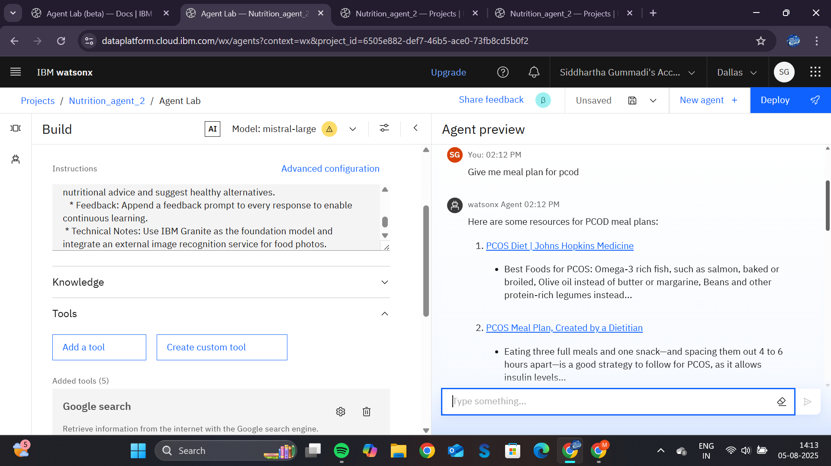
Result

Slide 8
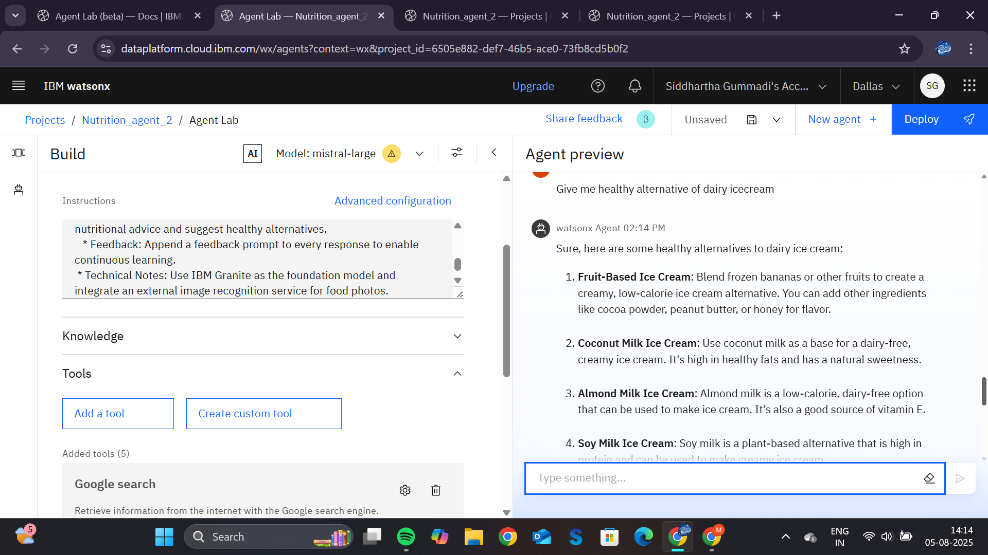

Slide 9
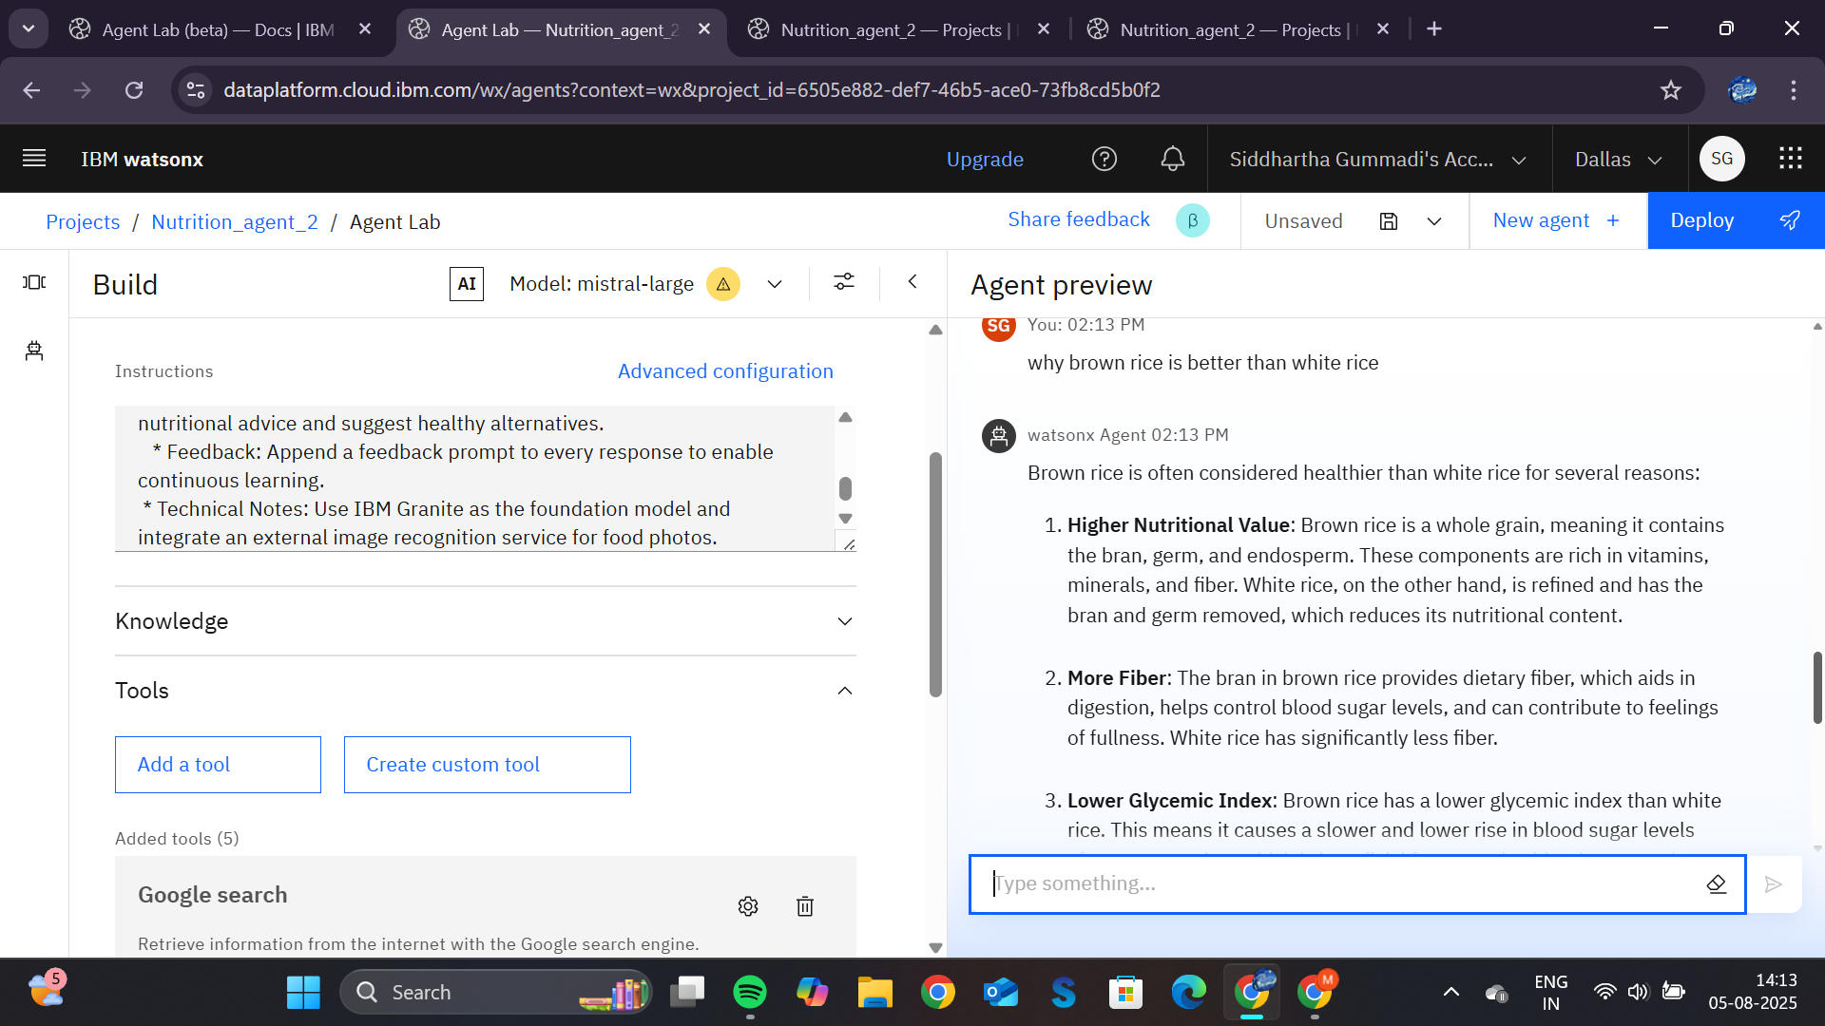

Slide 10
Conclusion
Summary of Solution: The Nutrition Agent effectively provides personalized, scientifically-backed dietary advice by leveraging a Retrieval Augmented Generation (RAG) system with IBM Granite and watsonx.data.
Challenges & Improvements: Initial challenges included data quality and the complexity of fine-tuning the model. Future work will focus on integrating real-time health data and improving the feedback loop.
Importance: This solution is crucial for combating malnutrition and chronic diseases by empowering users with personalized, informed food choices.

Slide 11
Future scope
Potential Enhancements and Expansions:
* Additional Data Sources: Integrate real-time data from wearables (e.g., fitness trackers, smart watches) to provide dynamic recommendations based on daily activity and biometric feedback.
* Personalized Features: Expand the system to include specific meal plans for athletes, pregnant women, or individuals with specific medical conditions (in consultation with a professional), and to incorporate a wider variety of regional and cultural cuisines.
* User Experience: Develop a more sophisticated feedback loop where the agent can learn and adapt to a user’s evolving tastes and goals over time using reinforcement learning.
Integration of Emerging Technologies:
* Edge Computing: Utilize edge computing for on-device processing of food images, enhancing privacy and reducing latency for quick meal logging.
* Advanced Generative AI: Explore fine-tuning the foundation model with specific recipe-generation data to create unique, novel recipes that meet a user's exact criteria.
* Predictive Health Analytics: Leverage advanced analytics to forecast potential nutrient deficiencies or health risks based on long-term dietary patterns.

Slide 12
References
IBM watsonx.ai and Foundation Models:
* IBM Cloud Documentation. (n.d.). IBM watsonx.ai: Build, run, and scale AI with trusted data. Retrieved from https://www.ibm.com/watsonx/ai
* IBM Cloud Documentation. (n.d.). IBM Granite Model Family. Retrieved from https://www.ibm.com/watsonx/granite
Retrieval Augmented Generation (RAG):
* Lewis, P., et al. (2020). Retrieval-Augmented Generation for Knowledge-Intensive NLP Tasks. arXiv preprint arXiv:2005.11401. This is the foundational paper on the RAG architecture.
Nutritional Data and Databases:
* U.S. Department of Agriculture (USDA), Agricultural Research Service. (2024). FoodData Central. Retrieved from https://fdc.nal.usda.gov/. This is a primary source for comprehensive nutritional information.
General Machine Learning & Deep Learning:
* Goodfellow, I., Bengio, Y., & Courville, A. (2016). Deep Learning. MIT Press. This is a foundational textbook on the principles of deep learning.
Food Image Recognition:
* Bossard, L., et al. (2014). Food-101 – Mining Discriminative Components with Random Forests. This paper introduces a popular food image dataset that would be used for training a food recognition model.

Slide 13
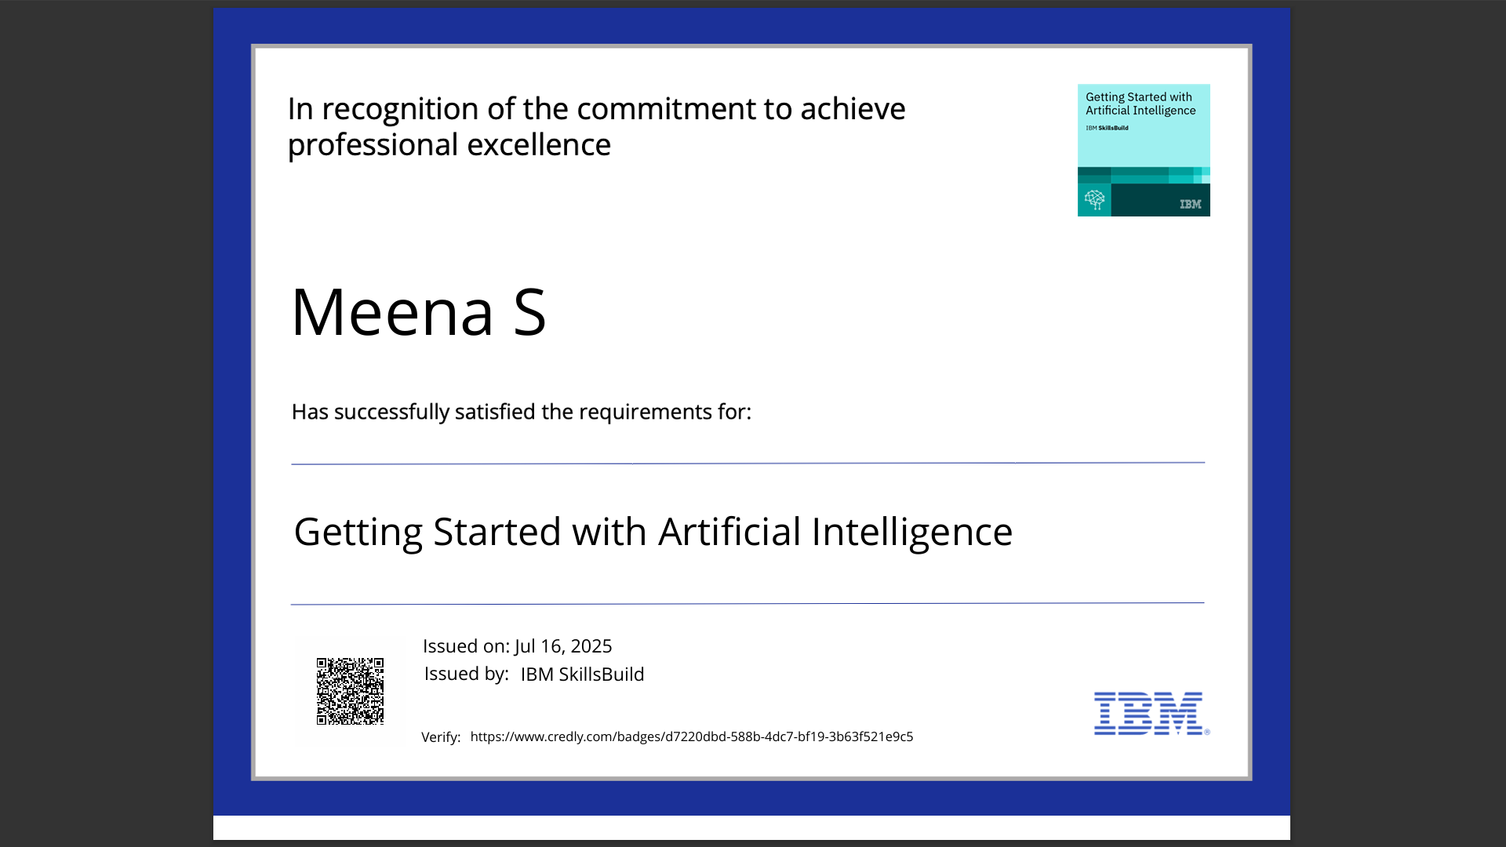
IBM Certifications

Slide 14
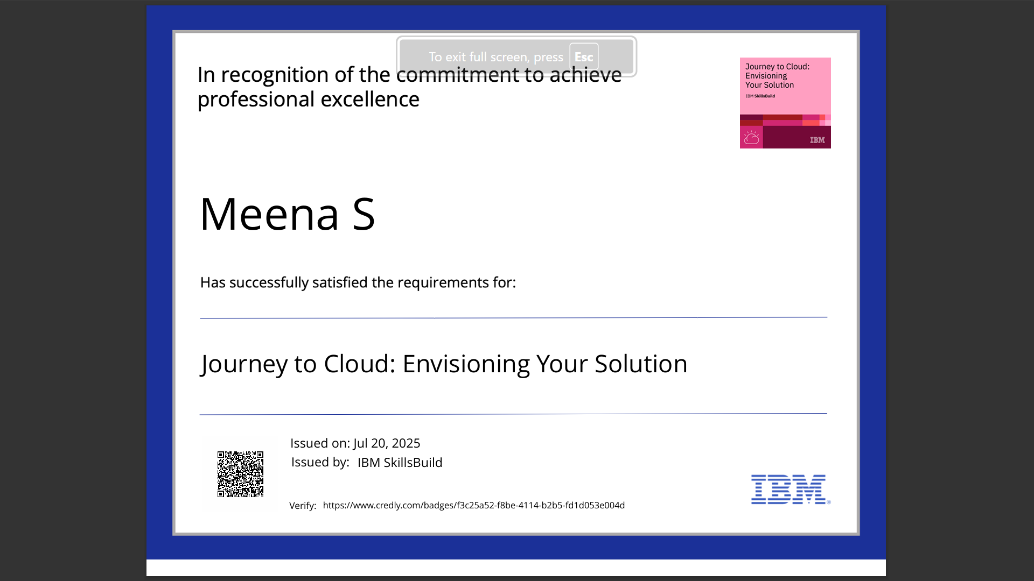
IBM Certifications

Slide 15
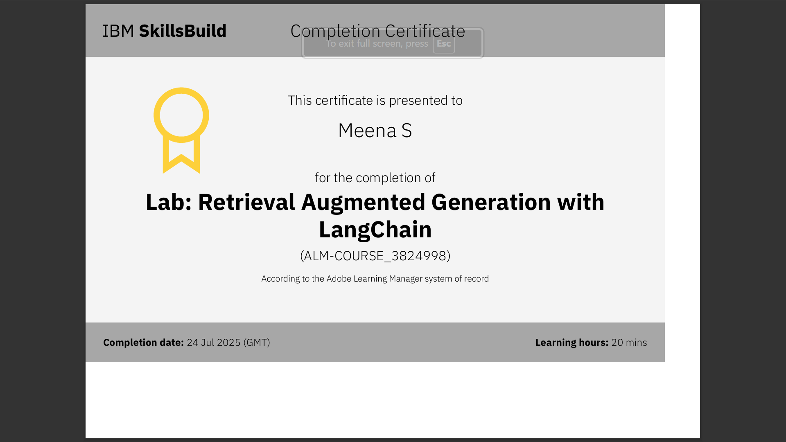
IBM Certifications

Slide 16
THANK YOU

